Slide 1

Games Research & Development Block 02 – Week 05

Slide 2

CSCT Conference '19
A festive day highlighting the department’s research and creativity, the Arnolfini June 20th 2019.
http://www.cems.uwe.ac.uk/~br-gaster/csct_conference19/
Final submissions accepted no later than: Friday March 15th, 2019

Slide 3

THIS WEEK
Videos / Demos
Thinking about Evaluation
Milestone Review Next Week
One-on-One Meetings

Slide 4
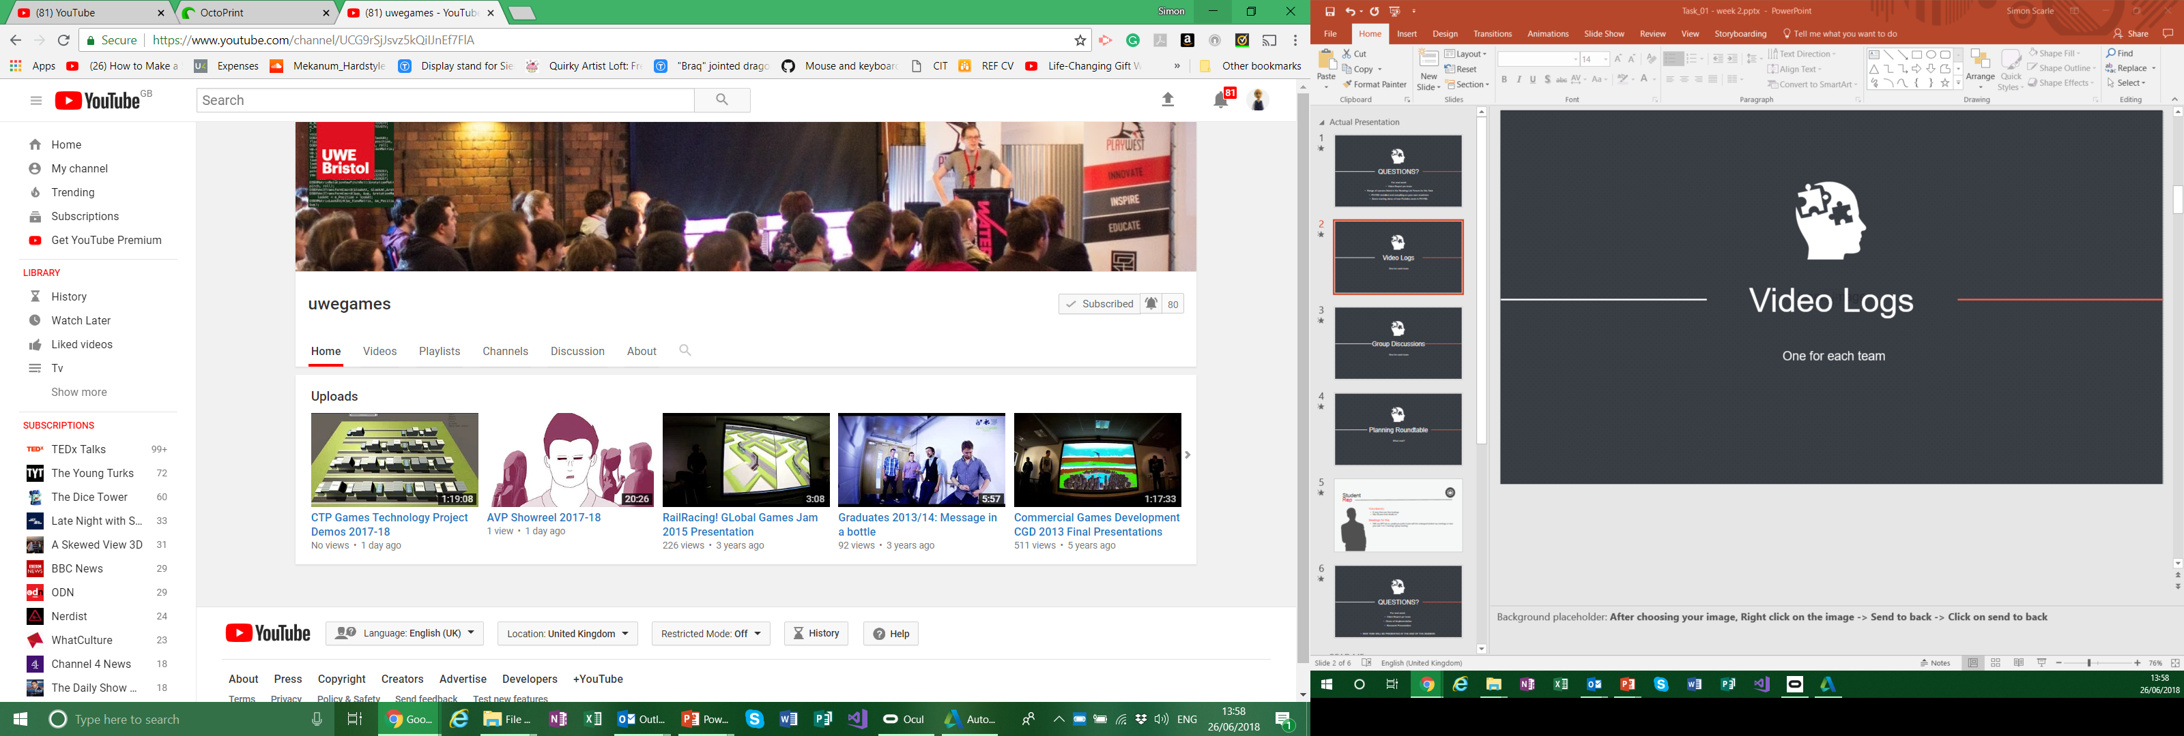
Video Logs
Place your screenshot here
Unlisted YouTube video.
I’ll add them to this years play list later!
If you think you made something pretty enough
+ TWEET + @UWEGamesMSc

Slide 5
DEMOS!
Place your screenshot here

Slide 6

Consider Your Evaluation
Project vs Product vs Research
What is the difference?
What do you want to find out?
What do stakeholders want to find out?
What do teaching staff want to know?
What does the academic / industry community want to know?

Slide 7
Consider Your Evaluation
How will you find out?
Who will you ask?
When will you ask?
How will you ask?
Any questionnaires must be shown to me before you carry out the work
Also need to see any cover sheets and detail of how the data is to be kept / used
Let’s avoid this:
https://youtu.be/G0ZZJXw4MTA

Slide 8
Consider Your Evaluation
How will you report? What goes where?
Process documentation vs
Academic / industry report
What is your target for report / paper?
For next week:
Begin to formalise all of the above (can iterate / adjust)
Formalise an evaluation schedule
Outline what is time-critical and what is not
Fill out ethics paperwork (if not already done so, but needs to match what you’re actually going to do)

Slide 9

Milestone Review
Interim progress review next week
Indicative content
Brief revisit of brief & proposal
Anything key that has changed, or additional research carried out?
Does it still align to client brief?
What has been implemented
Technical system overview
Does it correspond to previous milestone breakdown?
Onward Trajectory
Revisions to scope?
How evaluation will ascertain level of success

Slide 10
Milestone Review
10-15 minutes (ish) Presentation
Demo of what implemented so-far
On-going review of research being done
Outline of milestones going forward
Research Question
Milestones going forward
INCLUDING EVALUATION
What Journal(s)

Slide 11
Plan Your Evaluation
Make a user-evaluation plan (Goodman, et al., 2012: p.47) (See Reading List), has plenty of examples. Note that it is more commercial than we are looking for, but still useful.
“Should cover five areas:
Research questions you are trying to answer
Why it’s important to answer them
The technique you will use to answer each question
The resources […] you will need. […]
When and where the research activity will take place, and who will do it.”
Consider carefully the task you will ask users to carry out, and whether them doing so will answer what you need to know. Their tasks need to be meaningful and you should aim for your interaction with them once using your product to be as minimal as possible.
NOTE: INFORMED CONSENT – see the ethics forms

Slide 12
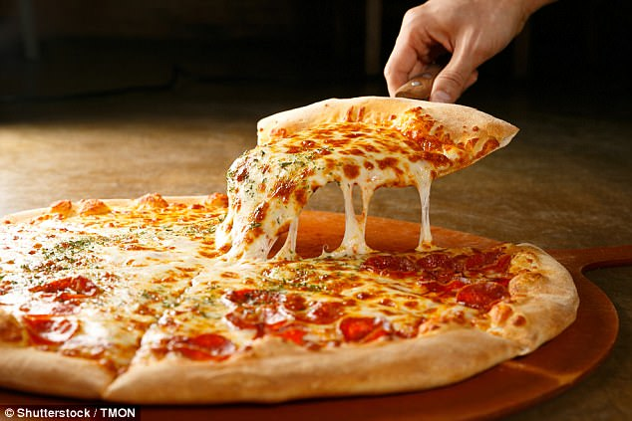
PIZZA PLAY TEST
Coming up: April 8th
Evening event for all Games Tech students to bring along stuff to play test by all comers
Good place to bring along your stuff for your evaluation
Also your games from CGS
DON’T RELY ON THIS

Slide 13
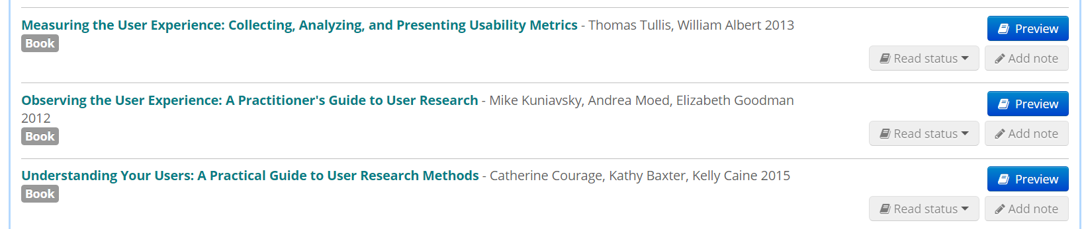
Plan Your Evaluation
Resources on module reading list, see in particular the user research planning sections.

Slide 14
Any questions?

Slide 15

One-One-One Meetings

Slide 16
NEXT WEEK
Milestone Review Presentation + Demo
Including Evaluation Plan
One-on-One Meetings to include
Evaluation –Schedule + Practical Arrangements

Slide 17
Any questions?

